Slide 1
GPUnet: Networking Abstractions for GPU Programs
Authors: MARK SILBERSTEIN, SANGMAN KIM, EMMETT WITCHEL
Affiliate: Technion—Israel Institute of Technology, University of Texas at Austin
Published in: ACM Transactions on Computer Systems (TOCS’16 CCF A)
Presented by: Junpeng Zhu
Advisor: Ji-feng He
May 13, 2019

Slide 2
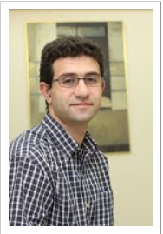
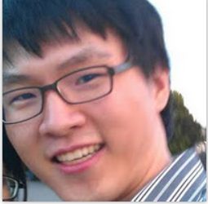
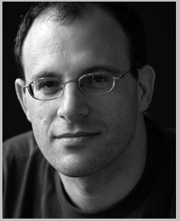
Authors
Now: Assistant Professor
Education: PhD in Computer Science at the Technion
Education: UT Austin as a post-doc
Interests: Building computer systems with programmable computational accelerators: GPU, FPGAs
Now: Pure Storage
Education: PhD in Computer Science at the UT Austin
Interests: Operating systems, security
Now: Professor at UT Austin
Education: Ph.D. in Electrical Engineering and Computer Science at MIT
Education: M.S. and B.S. in Computer Science, Stanford University
Interests: operating systems, architec-ture and security, high-performance and concurrent systems

Slide 3
OUTLINE
Introduction
Motivation & Example
Design Considerations
GPUnet Design
Experiments & Evaluation
Conclusions & Future Work

Slide 4
Introduction
GPUs have become the platform of choice for many types of parallel general-purpose applications
machine learning
molecular dynamics simulations
GPUs in complex software systems like network servers remains challenging
GPUs lack software abstraction to direct the flow of data within a system
leaving the developer with only low-level control over I/O

Slide 5
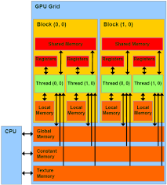
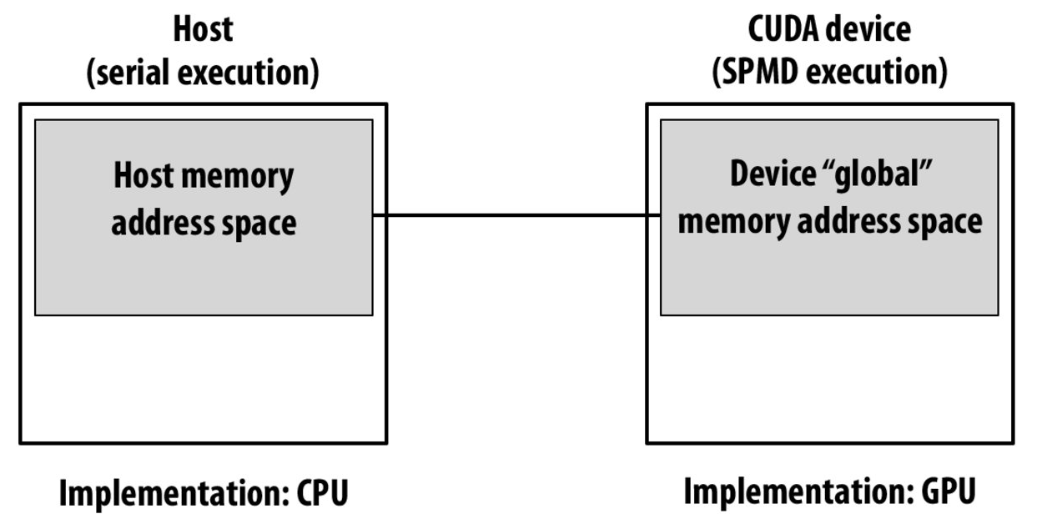
Introduction
Avoid to send data to a CPU or system memory
GPU hardware/software Model
CPU endpoint is not same to the GPU endpoint.
PCI Express
DMA

Slide 6
Introduction
Bad news: certain classes of applications that could benefit from the GPU’s computational density require unacceptable development costs to realize their full performance potential
GPU hardware architecture has matured to support general-purpose parallel workloads
GPU software stack has hardly evolved beyond bare-metal interfaces (E.g. memory transfer via DMA)

Slide 7
Introduction
Without core I/O abstractions like sockets available to GPU code
GPU programs that access the network must coordinate low-level, machine-specific details (DMA) among a CPU, GPU, and a NIC
This article introduces GPUnet:
a native GPU networking layer that provides a socket abstraction and high-level networking APIs to GPU programs

Slide 8
Introduction
GPUnet provides:
GPUnet enables individual threads in one GPU to communicate with threads in other GPUs or CPUs via standard and familiar socket interfaces, regardless of whether they are in the same or different machines.
GPUnet is designed to foster GPU adoption in two broad classes of high-throughput data center applications
Network servers for back-end data processing
scale-out distributed computing systems

Slide 9
Introduction
Three essential characteristics make developing efficient network abstractions for discrete GPUs challenging
massive parallelism,
slow access to CPU memory,
low single-thread performance.
The GPUnet prototype supports sockets for network communications over InfiniBand RDMA and supports interprocess communication on a local machine (often called UNIX-domain sockets)

Slide 10
OUTLINE
Introduction
Motivation & Example
Design Considerations
GPUnet Design
Experiments & Evaluation
Conclusions & Future Work

Slide 11
Motivation & Example
Problems
The use of GPUs in network servers or distributed systems poses significant challenges
The list of 200 popular general-purpose GPU applications recently published by NVIDIA has no mention of GPU-accelerated network services
Using GPUs in distributed applications results in impressive speedups but requires significant development efforts [2016]
GPU-native networking support does not yet exist

Slide 12
Motivation & Example
Enjoying the benefits of P2P DMA, however, requires intimate knowledge of hardware-specific APIs and characteristics, such as the underlying PCIe topology.
These issues turning their development into a low-level system programming task.
Modern CPU operating systems provide high-level I/O abstractions like sockets, which eliminate or hide this type of programming complexity from ordinary application developers.

Slide 13
Motivation & Example
Consider an internal data center network service for on-demand face-in-a-crowd photo labeling.
The algorithm detects faces in the input image (GPU), creates face descriptors,
Complex concurrency
Complex multistage pipelining
Complex network buffer management
fetches the name label for each descriptor from a remote database,
returns the location and the name of each recognized face in the image.

Slide 14
OUTLINE
Introduction
Motivation & Example
Design Considerations
GPUnet Design
Experiments & Evaluation
Conclusions & Future Work

Slide 15
Design Considerations
Sockets and Alternatives
The GPUnet interface uses sockets
standard, general, familiar, and convenient to use
RDMA is usually performed via VERBs API, and is difficult to use
MPI is quite uncommon in other networking applications, such as network servers.
GPUnet aims to support a broad range of server-side network services

Slide 16
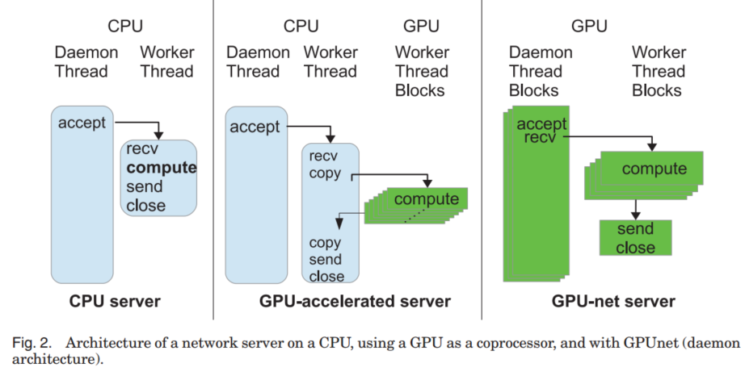
Design Considerations
All inputs are read on the CPU first and transferred to the GPU across a PCIe bus. It is needed to batch of work to amortize CPU-GPU communications overhead.
Network Server Organization
Daemon architecture: It is our hope that this model will make the computational
power of GPUs more easily accessible to networked services.
Daemo thread accepts connetions and transfer the socket to worker threads

Slide 17
Design Considerations
Two Architecture of GPUnet
daemon architecture
GPUnet makes it possible for GPU servers to handle multiple independent requests without having to batch them first (far right in Figure 2), much like multitasking in multicore CPUs.
Independent architecture
It is also possible to have a GPUnet server where each threadblock acts as an independent server, accepting, computing, and responding to requests.

Slide 18
OUTLINE
Introduction
Motivation & Example
Design Considerations
GPUnet Design
Experiments & Evaluation
Conclusions

Slide 19
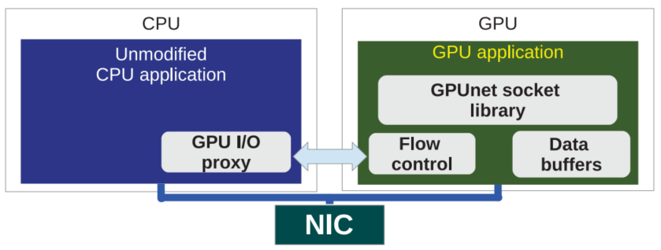
GPUnet Design
A Standard socket abstraction
Therefore, CPU and GPU enable all to share the NIC hardware, allowing concurrent use of a NIC by both CPU and GPU programs.
It enables: (1) GPU programs can access the network via standard socket abstractions provided by the GPUnet library. (2) CPU applications may use standard sockets to connect to remote GPU sockets. (3) A GPUnet endpoint has identical capabilities as a CPU network endpoint.
GPU I/O proxy coordinate GPU access to the NIC.
Network Buffer: GPUnet stores network buffers in GPU memory

Slide 20
GPUnet Design
The difference of processing model in CPU and GPU
GPUnet requires applications to invoke its API at the granularity of a single threadblock. All threads in a threadblock must invoke the same GPUnet call together in a coalesced manner
A traditional CPU network API is single threaded—that is, each thread can make independent API calls and receive independent results.

Slide 21
GPUnet Design
Two proposal in abstraction level
CPU+
Memory
GPU+
Memory
CPU
GPU
Memory
NIC

Slide 22
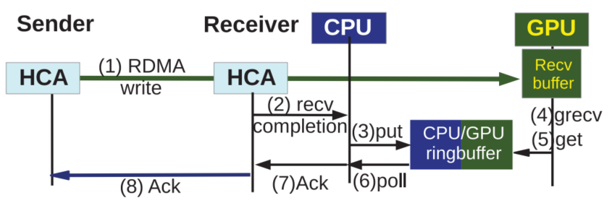
GPUnet Design
Information Exchange Example

Slide 23
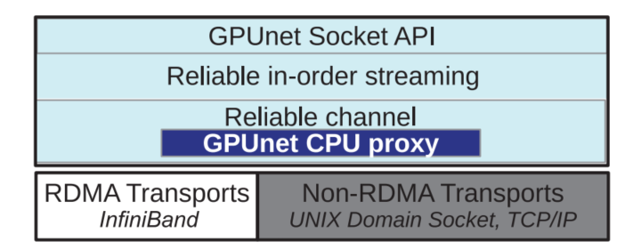
GPUnet Design
GPUnet Network Stack
Tasks Pipeline

Slide 24
OUTLINE
Introduction
Motivation & Example
Design Considerations
GPUnet Design
Experiments & Evaluation
Conclusions & Future Work

Slide 25
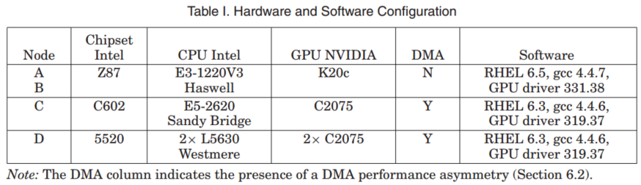
Experiments & Evaluation
Experiments Settings
All machines use CUDA 5.5.

Slide 26
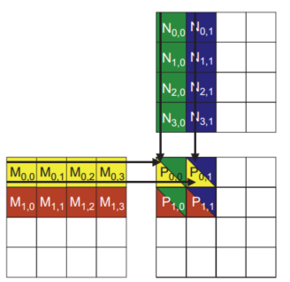
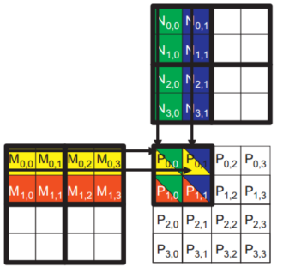
Experiments & Evaluation
Matrix Product

Slide 27
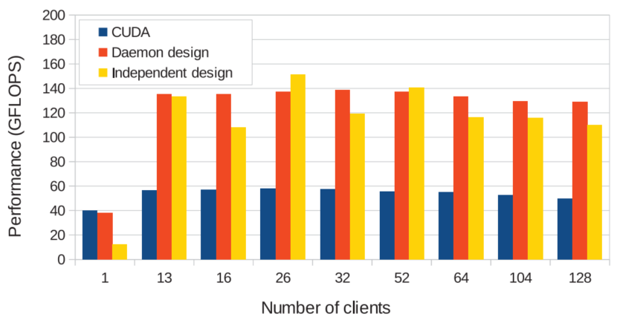
Experiments & Evaluation
Matrix Product
256*256 Matrices

Slide 28
OUTLINE
Introduction
Motivation & Example
Design Considerations
GPUnet Design
Experiments & Evaluation
Conclusions & Future Work

Slide 29
Conclusions & Future Work
GPUnet is the first system to provide native networking abstractions for GPUs
Developments in the GPU hardware and software stack may help to boost GPUNet performance and broaden its capabilities
The new NVIDIA GPUs architecture boost GPUnet performance

Slide 30
Conclusions & Future Work
These system enhancements continue the trend toward more flexible, versatile, and efficient GPU-accelerated systems where GPUs have more control over their I/O operations, underscoring the importance of the GPU-native high-level OS abstractions presented in this article for future GPUs.

